Slide 1
Congruent Triangles
Geometry
Chapter 4
Notes:
Geometry 4

Slide 2
This Slideshow was developed to accompany the textbook
Larson Geometry
By Larson, R., Boswell, L., Kanold, T. D., & Stiff, L.
2011 Holt McDougal
Some examples and diagrams are taken from the textbook.
Slides created by
Richard Wright, Andrews Academy
rwright@andrews.edu

Slide 3
4.1 Apply Triangle Sum Property
Classify Triangles by Sides
Equilateral Triangle
All congruent sides
Scalene Triangle
No congruent sides
Isosceles Triangle
Two congruent sides

Slide 4
4.1 Apply Triangle Sum Property
Classify Triangles by Angles
Equiangular Triangle
All congruent angles
Right Triangle
1 right angle
Acute Triangle
3 acute angles
Obtuse Triangle
1 obtuse angle

Slide 5
4.1 Apply Triangle Sum Property
Classify the following triangle by sides and angles
Notes:
Scalene, Acute
Isosceles, Right

Slide 6
4.1 Apply Triangle Sum Property
ΔABC has vertices A(0, 0), B(3, 3), and C(-3, 3). Classify it by is sides. Then determine if it is a right triangle.
Notes:
Find length of sides using distance formula
AB = √((3 – 0)² + (3 – 0)²) = √(9 + 9) = √18 ≈ 4.24
BC = √((-3 – 3)² + (3 – 3)²) = √((-6)² + 0) = √(36) = 6
AC = √((-3 – 0)² + (3 – 0)²) = √(9 + 9) = √18 ≈ 4.24
Isosceles
Check slopes to find right angles (perpendicular)
m_{AB} = (3 – 0)/(3 – 0) = 1
m_{BC} = (3 – 3)/(-3 – 3) = 0
m_{AC} = (3 – 0)/(-3 – 0) = -1
AB ⊥ AC so it is a right triangle

Slide 7
4.1 Apply Triangle Sum Property
A
Take a triangle and tear off two of the angles.
Move the angles to the 3rd angle.
What shape do all three angles form?
B
C
Triangle Sum Theorem
The sum of the measures of the interior angles of a triangle is 180°.
m∠A + m∠B + m∠C = 180°
Notes:
Straight line

Slide 8
4.1 Apply Triangle Sum Property
Exterior Angle Theorem
The measure of an exterior angle of a triangle = the sum of the 2 nonadjacent interior angles.
m∠1 = m∠A + m∠B
A
1
B
C
Notes:
Proof:
m∠A + m∠B + m∠ACB = 180° (triangle sum theorem)
m∠1 + m∠ACB = 180° (linear pair theorem)
m∠1 + m∠ACB = m∠A + m∠B + m∠ACB (substitution)
m∠1 = m∠A + m∠B (subtraction)

Slide 9
4.1 Apply Triangle Sum Property
Corollary to the Triangle Sum Theorem
The acute angles of a right triangle are complementary.
m∠A + m∠B = 90°
A
C
B
Notes:
The proof involves saying that all three angles = 180. Since m∠C is 90, m∠A + m∠B = 90.

Slide 10
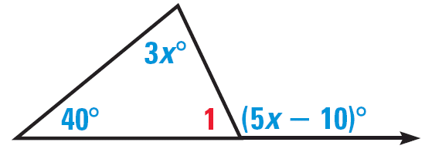
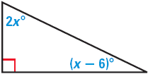
4.1 Apply Triangle Sum Property
Find the measure of ∠1 in the diagram.
Find the measures of the acute angles in the diagram.
Notes:
40 + 3x = 5x – 10 → 50 = 2x → x = 25
m∠1 + 40 + 3x = 180 → m∠1 + 40 + 3(25) = 180 → m∠1 + 40 + 75 = 180 → m∠1 = 65
2x + x – 6 = 90 → 3x = 96 → x = 32
Top angle: 2x → 2(32) = 64
Angle at right: x - 6 → 32 - 6 = 26

Slide 11
4.1 Apply Triangle Sum Property
221 #2-36 even, 42-50 even, 54-62 even = 28 total

Slide 12
Answers and Quiz
4.1 Answers
4.1 Quiz

Slide 13
4.2 Apply Congruence and Triangles
Congruent ≅
Exactly the same shape and size.
Congruent
Not Congruent

Slide 14
4.2 Apply Congruence and Triangles
A
D
C
B
F
E
ΔABC ≅ ΔDEF ΔABC ≅ ΔEDF
∠A ≅ ∠D ∠B ≅ ∠E ∠C ≅ ∠F
$\overline{AB}≅\overline{DE}$ $\overline{BC}≅\overline{EF}$ $\overline{AC}≅\overline{DF}$

Slide 15
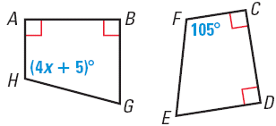
4.2 Apply Congruence and Triangles
In the diagram, ABGH ≅ CDEF
Identify all the pairs of congruent corresponding parts
Find the value of x and find m∠H.
Notes:
AB ≅ CD, BG ≅ DE, GH ≅ EF, AH ≅ CF
∠A ≅ ∠C, ∠B ≅ ∠D, ∠G ≅ ∠E, ∠H ≅ ∠F
4x + 5 = 105
4x = 100
x = 25
m∠H = 105°

Slide 16
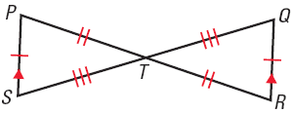
4.2 Apply Congruence and Triangles
Show that ΔPTS ≅ ΔRTQ
Notes:
All of the corresponding parts of ΔPTS are congruent to those of ΔRTQ by the indicated markings, the Vertical Angle Theorem and the Alternate Interior Angle theorem.

Slide 17
4.2 Apply Congruence and Triangles
Third Angle Theorem
If two angles of one triangle are congruent to two angles of another triangle, then the third angles are congruent.
?
?
75°
20°
75°
20°
Properties of Congruence of Triangles
Congruence of triangles is Reflexive, Symmetric, and Transitive
Notes:
75 + 20 + ? = 180
95 + ? = 180
? = 85

Slide 18
4.2 Apply Congruence and Triangles
In the diagram, what is m∠DCN?
By the definition of congruence, what additional information is needed to know that ΔNDC ≅ ΔNSR?
Notes:
m∠DCN = 75°; alt int angle theorem (or 3rd angle theorem)
DN ≅ SN, DC ≅ SR

Slide 19
4.2 Apply Congruence and Triangles
228 #4-16 even, 17, 20, 26, 28, 32-40 all = 20 total

Slide 20
Answers and Quiz
4.2 Answers
4.2 Quiz

Slide 21
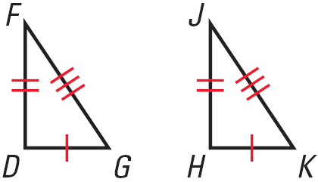
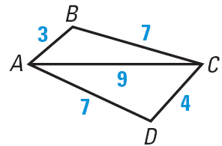
4.3 Prove Triangles Congruent by SSS
SSS (Side-Side-Side Congruence Postulate)
If three sides of one triangle are congruent to three sides of another triangle, then the two triangles are congruent
True or False
ΔDFG ≅ ΔHJK
ΔACB ≅ ΔCAD
Notes:
True
False

Slide 22
4.3 Prove Triangles Congruent by SSS
Given: $\overline{AB}≅\overline{DC}$; $\overline{AD}≅\overline{BC}$
Prove: ΔABD ≅ ΔCDB
B
A
D
C
Statements
Reasons
Notes:
AB ≅ DC; AD ≅ CB (given)
BD ≅ BD (reflexive)
ΔABD ≅ ΔCDB (SSS)

Slide 23
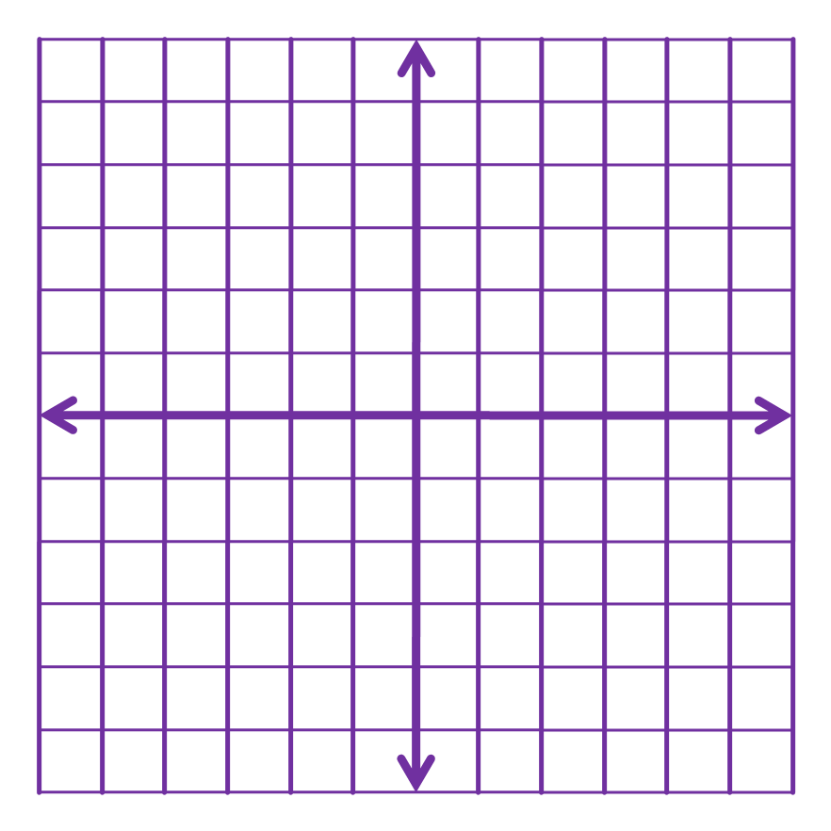
4.3 Prove Triangles Congruent by SSS
ΔJKL has vertices J(–3, –2), K(0, –2), and L(–3, –8). ΔRST has vertices R(10, 0), S(10, – 3), and T(4, 0). Graph the triangles in the same coordinate plane and show that they are congruent.
Notes:
JK = √((0 – (-3))² + (-2 – (-2))² = √(9 + 0) = 3
KL = √((-3 – 0)² + (-8 – (-2))² = √(9 + 36) = √45
JL = √((-3 – (-3))² + (-8 – (-2))² = √(0 + 36) = 6
RS = √((10 – 10)² + (-3 – 0)²) = √(0 + 9) = 3
ST = √((4 – 10)² + (0 – (-3))²) = √(36 + 9) = √45
RT = √((4 – 10)² + (0 – 0)²) = √(36 + 0) = 6

Slide 24
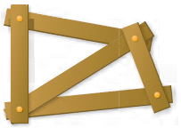
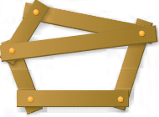
4.3 Prove Triangles Congruent by SSS
Determine whether the figure is stable.
236 #2-30 even, 31-37 all = 22 total
Extra Credit 239 #2, 4 = +2
Notes:
Not stable
Stable since has triangular construction
Not stable, lower section does not have triangular construction

Slide 25
Answers and Quiz
4.3 Answers
4.3 Quiz

Slide 26
4.4 Prove Triangles Congruent by SAS and HL
SAS (Side-Angle-Side Congruence Postulate)
If two sides and the included angle of one triangle are congruent to two sides and the included angle of another triangle, then the two triangles are congruent
The angle must be between the sides!!!

Slide 27
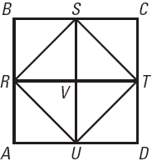
4.4 Prove Triangles Congruent by SAS and HL
Given: ABCD is square; R, S, T, and U are midpts; $\overline{RT}⊥\overline{SU}$; $\overline{SV}≅\overline{VU}$
Prove: ΔSVR ≅ ΔUVR
Statements
Reasons
Notes:
ABCD is square; R, S, T, and U are midpts; RT ⊥ SU; SV ≅ VU (given)
∠SVR and ∠UVR are rt angles (⊥ lines form 4 rt ∠)
∠SVR ≅ ∠UVR (all rt angles are congruent)
RV ≅ RV (reflexive)
ΔSVR ≅ ΔUVR (SAS)

Slide 28
4.4 Prove Triangles Congruent by SAS and HL
Right triangles are special
If we know two sides are congruent we can use the Pythagorean Theorem (ch 7) to show that the third sides are congruent
Hypotenuse
Leg
Leg

Slide 29
4.4 Prove Triangles Congruent by SAS and HL
HL (Hypotenuse-Leg Congruence Theorem)
If the hypotenuse and a leg of a right triangle are congruent to the hypotenuse and a leg of another right triangle, then the two triangles are congruent

Slide 30
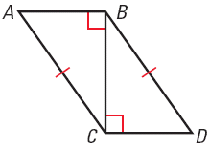
4.4 Prove Triangles Congruent by SAS and HL
Given: ∠ABC and ∠BCD are rt ∠s; $\overline{AC}≅\overline{BD}$
Prove: ΔACB ≅ ΔDBC
Statements
Reasons
Notes:
∠ABC and ∠BCD are rt ∠s; AC ≅ BD (given)
ΔACB and ΔDBC are rt Δ (def rt Δ)
BC ≅ CB (reflexive)
ΔACB ≅ ΔDBC (HL)

Slide 31
4.4 Prove Triangles Congruent by SAS and HL
243 #4-28 even, 32-48 even = 22 total

Slide 32
Answers and Quiz
4.4 Answers
4.4 Quiz

Slide 33
4.5 Prove Triangles Congruent by ASA and AAS
Use a ruler to draw a line of 5 cm.
On one end of the line use a protractor to draw a 30° angle.
On the other end of the line draw a 60° angle.
Extend the other sides of the angles until they meet.
Compare your triangle to your neighbor’s.
This illustrates ASA.
Notes:
Everyone’s triangle should be congruent

Slide 34
4.5 Prove Triangles Congruent by ASA and AAS
ASA (Angle-Side-Angle Congruence Postulate)
If two angles and the included side of one triangle are congruent to two angles and the included side of another triangle, then the two triangles are congruent
The side must be between the angles!

Slide 35
4.5 Prove Triangles Congruent by ASA and AAS
AAS (Angle-Angle-Side Congruence Theorem)
If two angles and a non-included side of one triangle are congruent to two angles and a non-included side of another triangle, then the two triangles are congruent
The side is NOT between the angles!

Slide 36
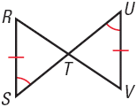
4.5 Prove Triangles Congruent by ASA and AAS
In the diagram, what postulate or theorem can you use to prove that ΔRST ≅ ΔVUT?
Notes:
∠RTS ≅ ∠UTV by Vert. Angles are Congruent
ΔRST ≅ ΔVUT by AAS

Slide 37
4.5 Prove Triangles Congruent by ASA and AAS
Flow Proof
Put boxes around statements and draw arrows showing direction of logic
Statement 2
What the Given Tells us
Statement 1
Given
Statement 5
Combine the previous statements
Statement 3
Definition from Picture or given
Statement 4
What the Given Tells us

Slide 38
4.5 Prove Triangles Congruent by ASA and AAS
Given: $\overline{AB}⊥\overline{BC}$, $\overline{DE}⊥\overline{EF}$, $\overline{AC}≅\overline{DF}$, ∠C ≅ ∠F
Prove: ΔABC ≅ ΔDEF
A
D
$\overline{AB}⊥\overline{BC}$
∠B is rt ∠
Given
Def ⊥ lines
B
C
E
F
$$\overline{DE}⊥\overline{EF}$$
∠E is rt ∠
∠B ≅ ∠E
Given
Def ⊥ lines
Rt ∠s are ≅
ΔABC ≅ ΔDEF
$$\overline{AC}≅\overline{DF}$$
AAS
Given
∠C ≅ ∠F
Given

Slide 39
4.5 Prove Triangles Congruent by ASA and AAS
C
Given: ∠CBF ≅ ∠CDF, $\overline{BF}≅\overline{FD}$
Prove: ΔABF ≅ ΔEDF
B
D
∠CBF ≅ ∠CDF
F
Given
A
E
∠CBF, ∠ABF supp
∠ABF ≅ ∠EDF
Linear Pair Post.
≅ Supp. Thm.
ΔABF ≅ ΔEDF
∠CDF, ∠EDF supp
ASA
Linear Pair Post.
$$\overline{BF}≅\overline{FD}$$
∠BFA ≅ ∠DFE
Given
Vert. ∠s ≅

Slide 40
4.5 Prove Triangles Congruent by ASA and AAS
252 #2-20 even, 26, 28, 32-42 even = 18 total

Slide 41
Answers and Quiz
4.5 Answers
4.5 Quiz

Slide 42
4.6 Use Congruent Triangles
By the definition of congruent triangles, we know that the corresponding parts have to be congruent
CPCTC
Corresponding Parts of Congruent Triangles are Congruent
Your book just calls this “definition of congruent triangles”

Slide 43
4.6 Use Congruent Triangles
To show that parts of triangles are congruent
First show that the triangles are congruent using
SSS, SAS, ASA, AAS, HL
Second say that the corresponding parts are congruent using
CPCTC or “def ≅ Δ”

Slide 44
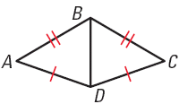
4.6 Use Congruent Triangles
Write a plan for a proof to show that ∠A ≅ ∠C
Show that $\overline{BD}≅\overline{BD}$ by reflexive
Show that triangles are ≅ by SSS
Say ∠A ≅ ∠C by def ≅ Δ or CPCTC

Slide 45
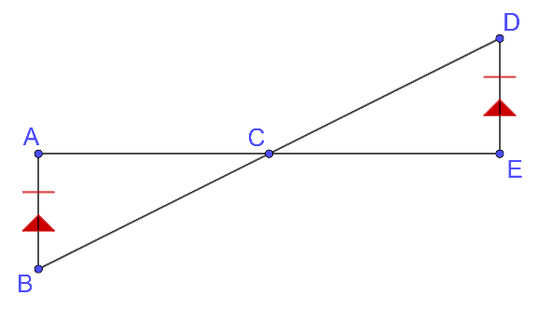
4.6 Use Congruent Δ
Given: $\overline{AB}≅\overline{DE}$, $\overline{AB}∥\overline{DE}$
Prove: C is the midpoint of $\overline{AB}$
Notes:
$\overline{AB}≅\overline{DE}$, $\overline{AB}∥\overline{DE}$ (given)
∠B ≅ ∠D, ∠A ≅ ∠E (Alt. Int. ∠ Thrm)
ΔABC ≅ ΔEDC (ASA)
$\overline{AC}≅\overline{CE}$ (CPCTC)
C is midpoint of $\overline{AE}$ (Def midpoint)

Slide 46
4.6 Use Congruent Triangles
259 #2-10 even, 14-28 even, 34, 38, 41-46 all = 21 total
Extra Credit 263 #2, 4 = +2

Slide 47
Answers and Quiz
4.6 Answers
4.6 Quiz

Slide 48
4.7 Use Isosceles and Equilateral Triangles
Parts of an Isosceles Triangle
Vertex Angle
Leg
Leg
Base Angles
Base

Slide 49
4.7 Use Isosceles and Equilateral Triangles
Base Angles Theorem
If two sides of a triangle are congruent, then the angles opposite them are congruent.
Converse of Base Angles Theorem
If two angles of a triangle are congruent, then the two sides opposite them are congruent.

Slide 50
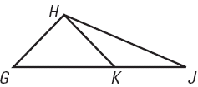
4.7 Use Isosceles and Equilateral Triangles
Complete the statement
If $\overline{HG}≅\overline{HK}$, then ∠ ? ≅ ∠ ? .
If ∠KHJ ≅ ∠KJH, then ? ≅ ? .
Notes:
∠HKG ≅ ∠HGK
KJ ≅ KH

Slide 51
4.7 Use Isosceles and Equilateral Triangles
Corollary to the Base Angles Theorem
If a triangle is equilateral, then it is equiangular.
Corollary to the Converse of Base Angles Theorem
If a triangle is equiangular, then it is equilateral.

Slide 52
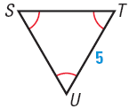
4.7 Use Isosceles and Equilateral Triangles
Find ST
Find m∠T
Notes:
ST = 5
m∠T = 60° (all angles in equilateral/equiangular triangles are 60°)

Slide 53
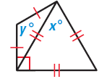
4.7 Use Isosceles and Equilateral Triangles
Find the values of x and y
What triangles would you use to show that ΔAED is isosceles in a proof?
C
B
8 ft
E
8 ft
D
A
Notes:
x = 60; equilateral triangle
Each base angle by y; 60 + ? = 90 → ? = 30
Angle sum theorem: 30 + 30 + y = 180 → y = 120
ΔABD, ΔDCA

Slide 54
4.7 Use Isosceles and Equilateral Triangles
267 #2-20 even, 24-34 even, 38, 40, 46, 48, 52-60 even = 25 total

Slide 55
Answers and Quiz
4.7 Answers
4.7 Quiz

Slide 56
4.8 Perform Congruence Transformations
Transformation is an operation that moves or changes a geometric figure to produce a new figure
Original figure → Image

Slide 57
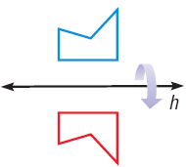
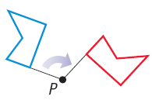
4.8 Perform Congruence Transformations
Reflection
Translation
Rotation

Slide 58
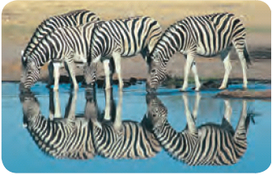
4.8 Perform Congruence Transformations
Name the type of transformation shown.
Notes:
Reflection

Slide 59
4.8 Perform Congruence Transformations
Congruence Transformation
The shape and size remain the same
Translations
Rotations
Reflections

Slide 60
4.8 Perform Congruence Transformations
Translations
Can describe mathematically
(x, y) → (x + a, y + b)
Moves a right, b up
b
a

Slide 61
4.8 Perform Congruence Transformations
Reflections
Can be described mathematically by
Reflect over y-axis: (x, y) → (-x, y)
Reflect over x-axis: (x, y) → (x, -y)

Slide 62
4.8 Perform Congruence Transformations
Figure WXYZ has the vertices W(-1, 2), X(2, 3), Y(5, 0), and Z(1, -1). Sketch WXYZ and its image after the translation (x, y) → (x – 1, y + 3).

Slide 63
4.8 Perform Congruence Transformations
The endpoints of $\overline{RS}$ are R(4, 5) and S(1, -3). A transformation of $\overline{RS}$ results in the image $\overline{TU}$, with coordinates T(4, -5) and U(1, 3). Tell which transformation and write the coordinate rule.
Notes:
Reflect over x-axis (x, y) → (x, -y)

Slide 64
4.8 Perform Congruence Transformations
Rotations
Give center of rotation and degree of rotation
Rotations are clockwise or counterclockwise
90°
45°

Slide 65
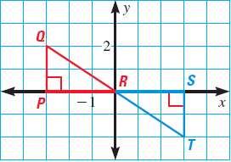
4.8 Perform Congruence Transformations
Tell whether ΔPQR is a rotation of ΔSTR. If so, give the angle and direction of rotation.
Notes:
180° (either direction is correct)

Slide 66
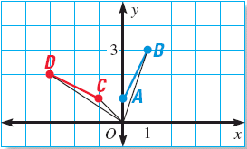
4.8 Perform Congruence Transformations
Tell whether ΔOCD is a rotation of ΔOAB. If so, give the angle and direction of rotation.
276 #2-42 even, 46-50 even = 24 total
Extra Credit 279 #2, 6 = +2
Notes:
Not a rotation

Slide 67
Answers and Quiz
4.8 Answers
4.8 Quiz

Slide 68
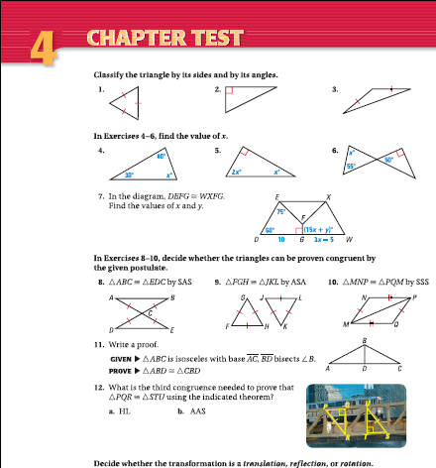
4.Review
286 #1-15 = 15 total

